Slide 1

CreativePulse Media – Data Analysis for Client Retention & Growth
Using Data to Build Stronger Client Relationships and Better Campaign Results
Jessica William

Slide 2

INTRODUCTION – The Challenge
Challenges:
To show clear ROI (Return on Investment) to its clients.
Retain clients
Improve campaign performance
Question:
How can data analysis help CreativePulse Media retain clients and improve campaign performance?

Slide 3

What We Should Be Tracking
Here’s a breakdown of the most critical indicators:
Click-through Rate (CTR) – Are the ads engaging?
Lead Conversion Rate – Are clicks turning into potential customers?
Engagement Rate – Are people interacting with the content?
Cost per Lead – Are we spending efficiently?
Client Feedback + Contract Status – Who’s at risk of leaving?
These give us a full picture of what’s working—and where we need to improve.

Slide 4
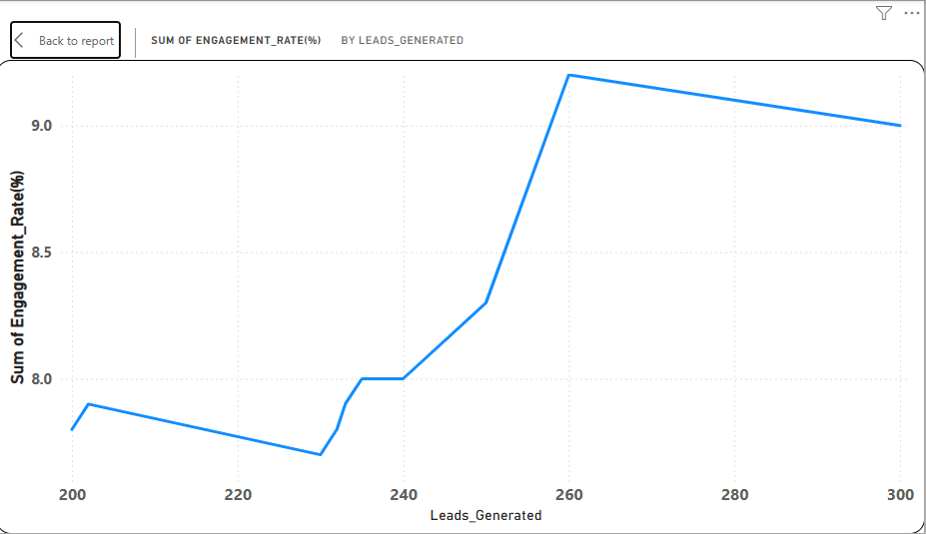
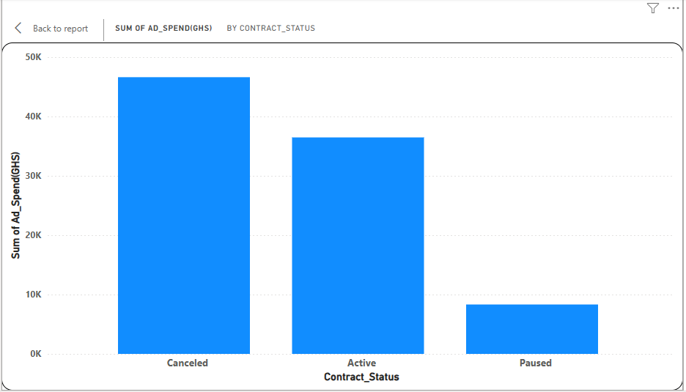
KEY FINDINGS
1. High Engagement Doesn’t Always Lead to Conversions
Some campaigns with strong CTR and engagement had low lead conversions.
Indicates a gap between attention and action, possibly due to misaligned messaging or landing page issues.
3. Clients with High Ad Spend Still Pausing Contracts
A few high-spend clients paused/canceled despite healthy performance metrics.
Suggests they may not perceive value due to lack of clarity or alignment with their business goals.
2. Industry-Based Performance Gaps
Certain industries (e.g. Education, Retail) have consistently lower conversion rates.

Slide 5
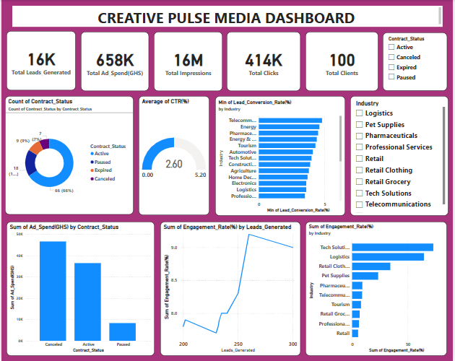
VISUALIZATION

Slide 6
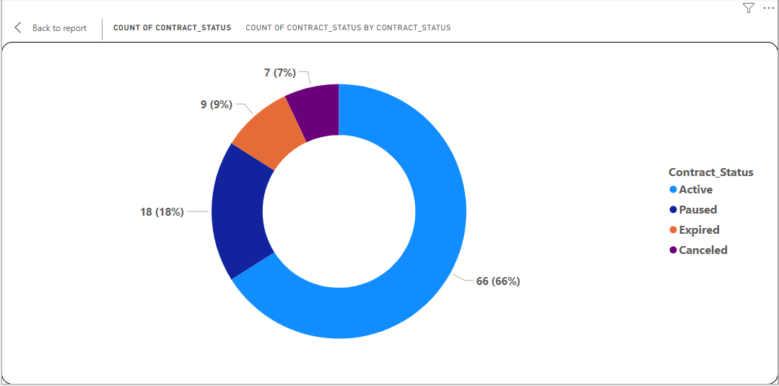
The Business Problem – Why Clients Are Leaving
Let’s be honest—clients aren't always leaving because your campaigns failed. Here's what I found:
Some clients have strong metrics, but still cancel—because they probably don’t understand the return on their investment.
Reporting might be too technical or unclear—making it hard for clients to see progress.
In other cases, budget shifts or market changes are at play.
And sometimes, clients just don’t feel supported or informed.

Slide 7
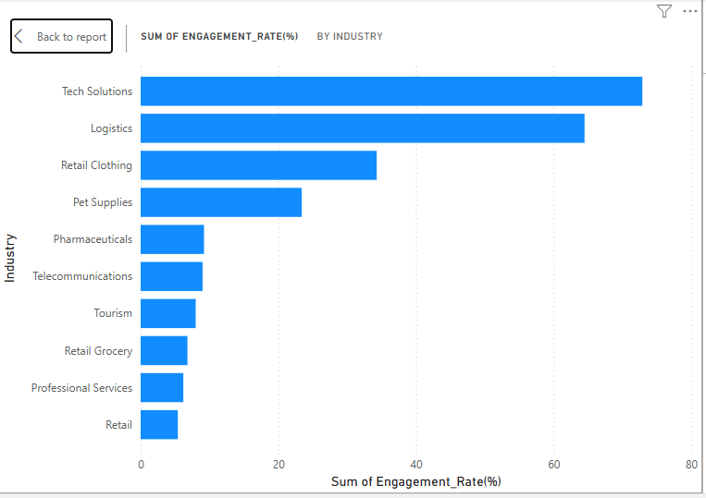
Recommendation
Improve Campaign Performance: Compare campaigns by industry to optimize strategy.
Increase Client Retention: Tailor reports to client goals (lead generation, brand awareness, etc.)
Strengthen Communication: By giving monthly performance summaries. Highlight what worked, what didn’t, and next steps.

Slide 8

Monthly Performance Summary
Scenario
Imagine sending a client a report that says:
‘Your last campaign generated 240 leads with a 4.3% conversion rate—15% above industry average. Based on that, we recommend increasing video ads on Instagram where your audience responds best.’
That’s how data builds trust. It’s not just a spreadsheet—it’s a story of success, progress, and partnership.

Slide 9

SUMMARY
CreativePulse Media can leverage data analysis to better understand why clients pause or cancel contracts despite seemingly strong campaign metrics.
By focusing on transparent reporting, tailored campaign optimization, and effective communication through data storytelling, the agency can improve client retention and campaign ROI.
Hiring a dedicated data analyst will enable the agency to harness these insights systematically, making data-driven decisions that enhance service quality and client trust.

Slide 10

Thank You

